Slide 1

Green Pace
Security Policy Presentation
Developer: Jean Petit

Slide 2

OVERVIEW: DEFENSE IN DEPTH
As long data is being stored digitally, there will always be questions about how to make sure it’s only accessible to users with permission to access it, while keeping it away from be unauthorized users.
This diagram shows how the different security layers are laid out and what each layer consists of

Slide 3
THREATS MATRIX
The four different threat levels that dictate how serious a threat is
Likely Threat that is more likely to happen than the majority of other threats | Priority Serious thread that needs to be addressed immediately
Low priority Threat that has a very low potential of causing serious damage | Unlikely Threat that ha a very low chance of actually happening

Slide 4
10 PRINCIPLES
Validate Input Data
Heed Compiler Warnings
Architect and Design for Security Policies
Keep It Simple
Default Deny
Adhere to the Principle of Least Privilege
Sanitize Data sent to Other Systems
Practice Defense In Depth
Use Effective Quality Assurance Techniques
Adopt a Secure Coding Practice

Slide 5
CODING STANDARDS
Do not case to an out-of-range enumeration value
Use valid reference, pointers, and iterators to reference elements of a container
Do not attempt to create a std::string from a null pointer
Do not store an already owned pointer value in an unrelated smart pointer
Properly de-allocate dynamically allocated resources
Use a static assertion to test the value of a constant expression
Handle all exceptions thrown before main() begins executing
Do not alternately input and output from a file stream without an intervening position calling
Do not invoke virtual functions from constructors or destructors
Value returning functions must return a value from all exit paths

Slide 6
ENCRYPTION POLICIES
Encryption at Rest: Encryption at rest is a method by which data is encrypted before being saved onto a hard drive. This ensures that an attacker who gains access to the hard drive encounters the data in its encrypted form, thus enable to read it unless the encryption key is also found.
Encryption at Flight: This is a method by which data is encrypted while it’s travelling from point A to point B. This prevent a hacker from reading the data if it’s intercepted in its travel path. But it is good to keep in mind that the data may not necessarily be encrypted at its origin and/or destination. A good example of that is Https
Encryption in Use: Data in use is data that is loaded into memory for use by a user or application. When the data is compromised at the memory level, the hacker may get access to both the encrypted data and the encryption key, making it easy for them to decrypt and read the data.

Slide 7
TRIPLE-A POLICIES
Authentication: Authentication is the process of verifying the user is who they say they are. This is usually done by asking the user to supply a username and password, which is compared against credentials saved in a database. Once the user is confirmed the be who they say they are, access is granted.
Authorization: Authorization happens right after the user has been authenticated. It is the process of determining what level of access the user has within the system. Depending on the level of access, a user may have unrestricted access to the system (example: an administrator) or has access to only certain part of the system. For instance, an accountant may have access to the financial part of the system while being unable to run reports, which is typically reserved for an Operations Manager.
Accounting: Accounting is the process by which a user is being monitored while they navigate the system. Their actions are recorded and saved in a log. That way, it will be possible to determine what they were doing, which database were accessed, and what actions were taken among many other things.

Slide 8
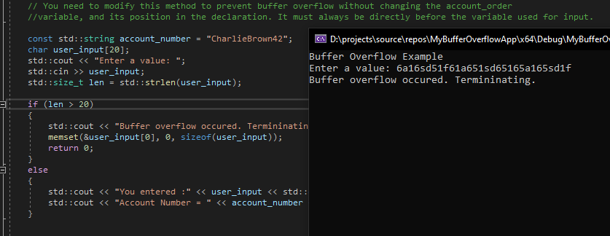
Unit Testing
How to handle buffer overflow?

Slide 9

AUTOMATION SUMMARY

Slide 10
TOOLS
DevSecOps pipeline is a normal Continuous Integrartion/Continuous Development (CI/CD) pipeline that integrates security practices and tooling to the Software Development Life Cycle
When security is integrated into DevOps, a number of new tools are added to the process like Scanning, threat intelligence, policy enforcement and static analysis. Scanning, for example occurs at the very end of the pre-production phase, right before the Transition and Health Check that happens at the beginning of the Production phase

Slide 11
RISKS AND BENEFITS
Security vulnerabilities cannot be eliminated. But keeping security first will help keeping the vulnerability issues low, while also being proactive when it comes to responding to threat. Preventing issues from happening, or at the very least, catching them early in the process is always less expensive to handle than catching them later in the process.
Another important aspect is to design a security policy and enforce it, while also keeping it updated and making sure the latest threats are also handled.

Slide 12
RECOMMENDATIONS
Keeping up with the latest technology as well as the latest threat is highly recommended as it provides a way to keep the data secure and keeps the most seasoned hacker at bay.

Slide 13
CONCLUSIONS
In conclusion, one the most important things is to keep security in mind since the very early stages of the development process. Also, keeping up with the latest threat as well as new technologies to defend against them is crucial in the battle to protect our data. Once the security policies are designed, it is important to enforce them always. As a policy that is just on paper collecting dust in a drawer is of no help when it comes to protecting data. And last but not least, running tests and scanning for potential vulnerabilities often will help in discovering them early, or hopefully before they are discovered and exploited by bad actors.

Slide 14
REFERENCES
A Brief History of Computer Viruses & What the Future Holds. (2022, October 20). usa.kaspersky.com. Retrieved December 13, 2022, from https://usa.kaspersky.com/resource-center/threats/a-brief-history-of-computer-viruses-and-what-the-future-holds
Start with Security: A Guide for Business. (2015, June 29). Federal Trade Commission. Retrieved December 13, 2022, from https://www.ftc.gov/business-guidance/resources/start-security-guide-business
What is a DevSecOps Pipeline? (n.d.). Check Point Software. Retrieved December 13, 2022, from https://www.checkpoint.com/cyber-hub/cloud-security/devsecops/what-is-a-devsecops-pipeline/

